Slide 1
Heavy Hitters Latency Quantile Estimation
Rana Shahout
Joint work with: Ran Ben Basat and Roy Friedman

Slide 2
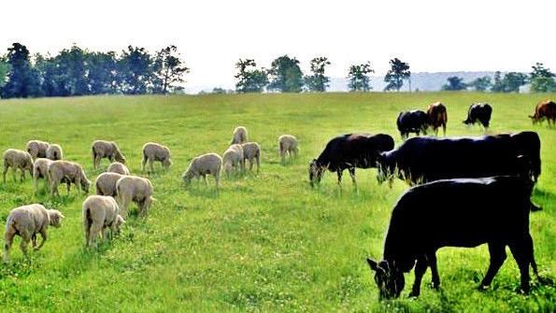

Slide 3
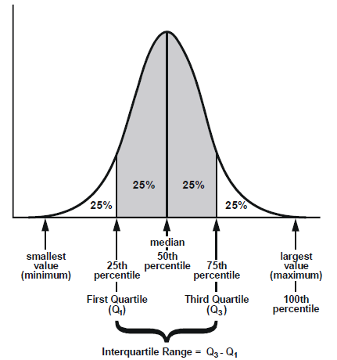


Overview of the talk
Quantiles
Big Data Algorithms
Streaming Model

Slide 4
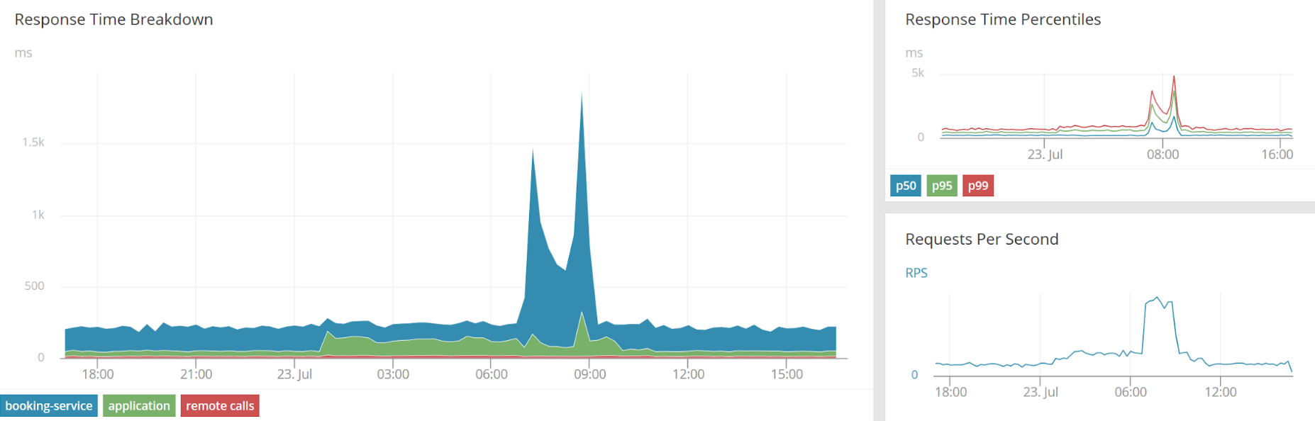
Monitoring Latencies of Web Requests
Traffic Around us

Slide 5
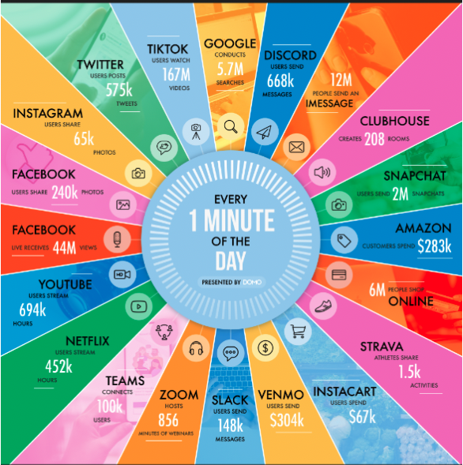
Data Never Sleeps!

Slide 6
Traffic as a data stream
  Data streams are massive, unbounded, possibly infinite
  Enter at a high-speed rate
Notes:
We can think that traffic is a data stream and
Many large sources of data are best modeled as data streams.
A stream is a large data set that is continuous, massive, unbounded, and possibly infinite.
In addition, the data is enter at a very high speed rate.

Slide 7
Lack of Memory
  The system can’t store the entire stream, but only a small fraction of it
  What portion should we keep in the limited memory?

Slide 8
Streaming Algorithm
  receives data in a stream, item by item
  uses memory sublinear in N (stream length)
  at the end, computes the answer
  Challenges:
      Stream length very large
      No random access to data
Main objective:
Space!

Slide 9
Calculations using limited memory
  Seek algorithms to find approximate answers
  How “good” are the results?
    Answer with error, and gurantee a bound on the error

Slide 10
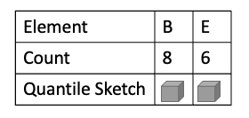
Space Saving (SS)
Keep k items and counts initially zero
Count first k distinct item exactly
Only over-estimation errors
Frequency estimation is more accurate for significant elements

Slide 11
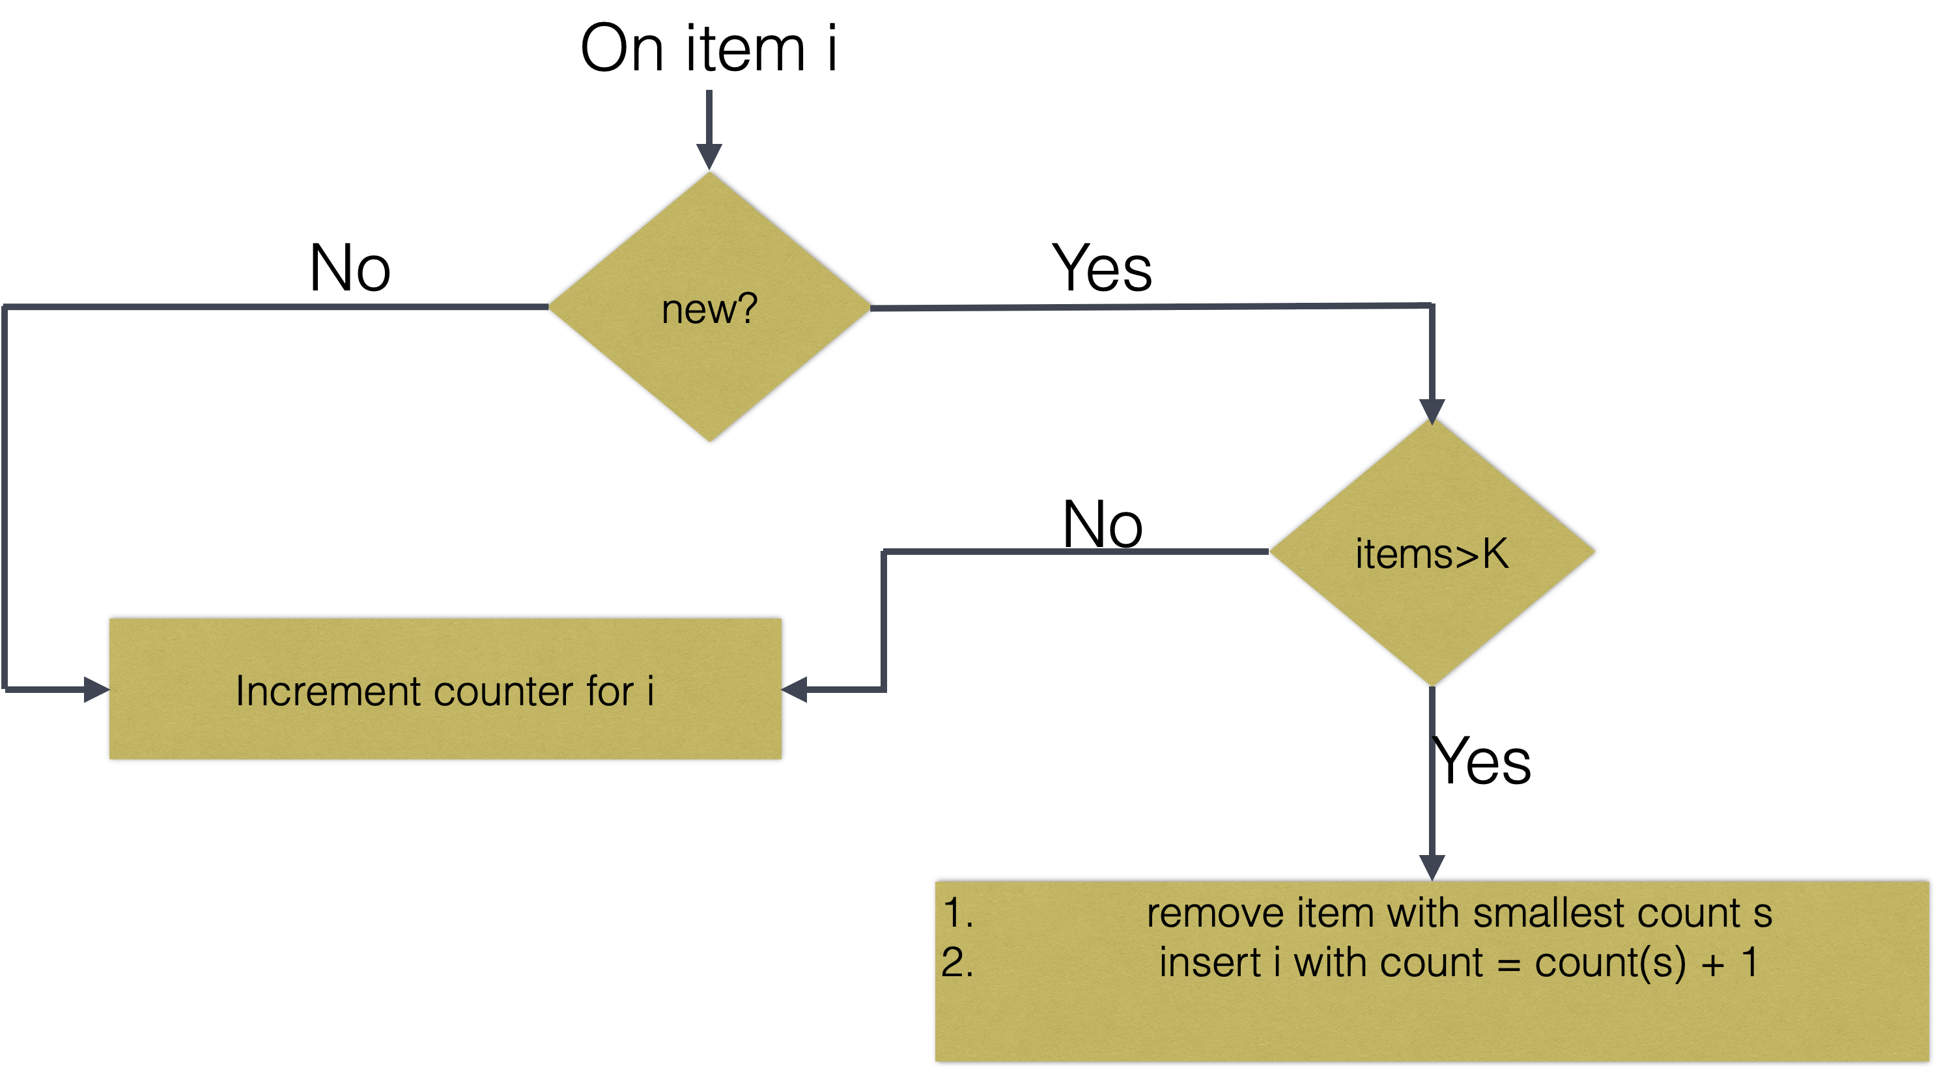
Space Saving

Slide 12
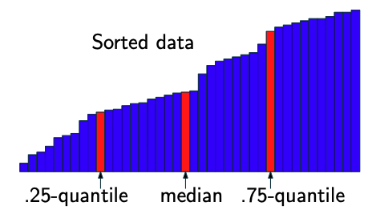
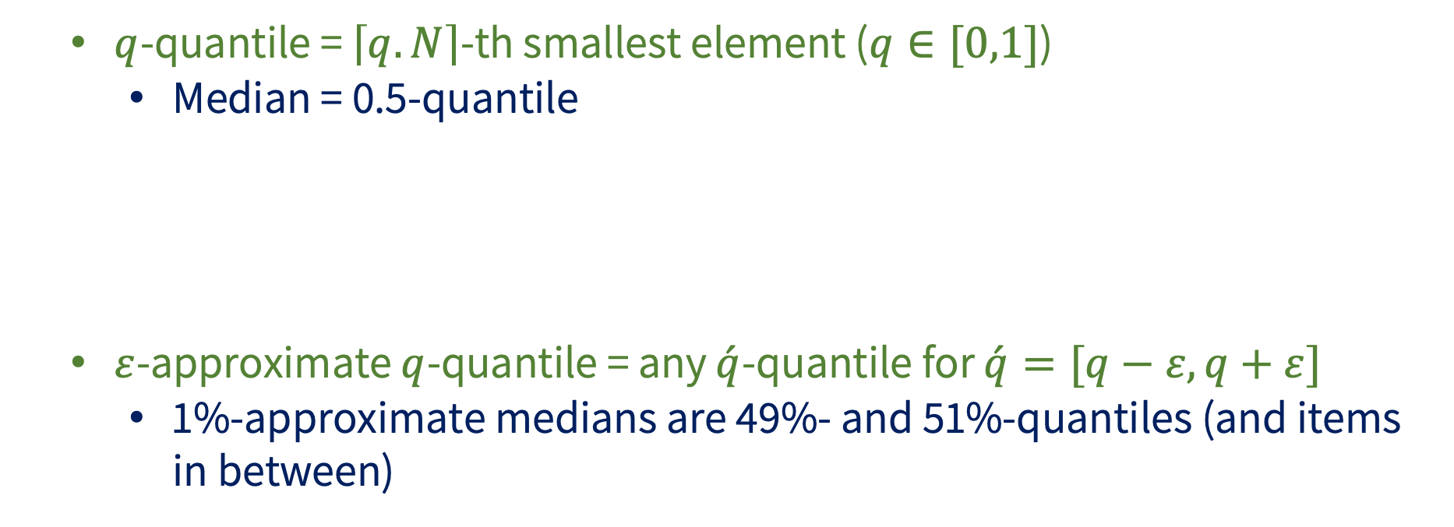
How to define approximate quantile?
  $q$-quantile = $\left\lceil q.N\right\rceil$-th smallest element ($q∈[0,1]$)
    Median = 0.5-quantile
  $ε$-approximate $q$-quantile = any $\acute{q}$-quantile for $\acute{q}=[q−ε, q+ε]$
    1%-approximate medians are 49%- and 51%-quantiles (and items in between)

Slide 13
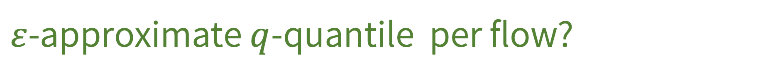
$ε$-approximate $q$-quantile per flow?
  Need to allocate separate sketch instance for each ID
  Infeasible amount of memory!
  We consider tracking the quantiles for the heavy-hitters (most frequent items) without knowing them beforehand
Heavy-hitters

Slide 14
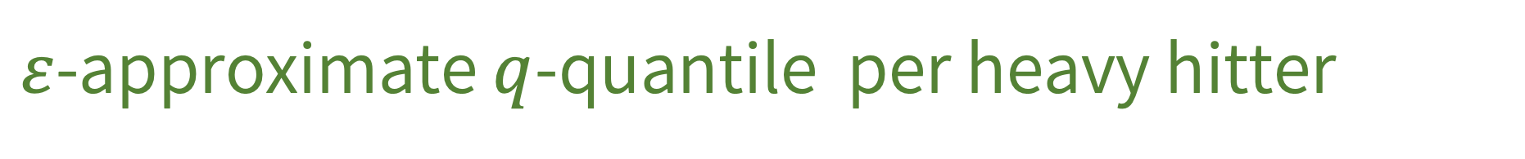
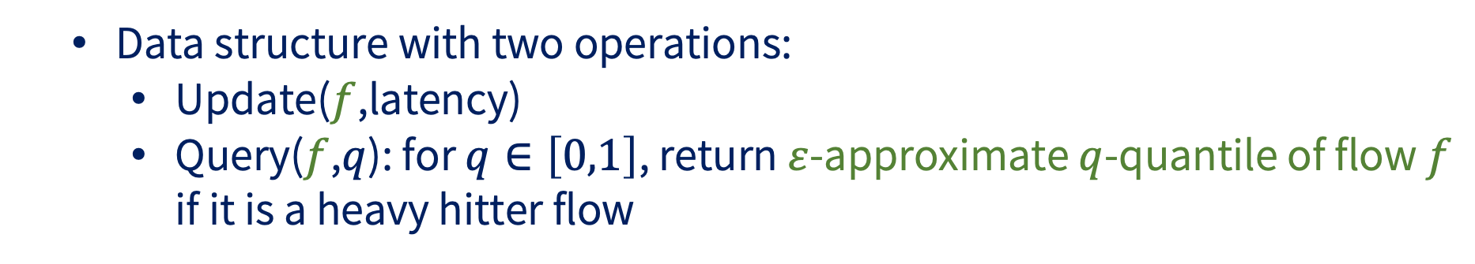
$ε$-approximate $q$-quantile per heavy hitter
  Data structure with two operations:
    Update($f$,latency)
    Query($f$,$q$): for $q∈\left[0,1\right]$, return $ε$-approximate $q$-quantile of flow $f$ if it is a heavy hitter flow

Slide 15

Several approaches:
  Sampling
Sampling

Slide 16

Several approaches:
  Sketching: Sketching Algorithm that augments a quantile sketch within each entry of a heavy hitter algorithm
Sketching

Slide 17

Several approaches:
  SQUAD: combines sampling and sketching
SQUAD

Slide 18

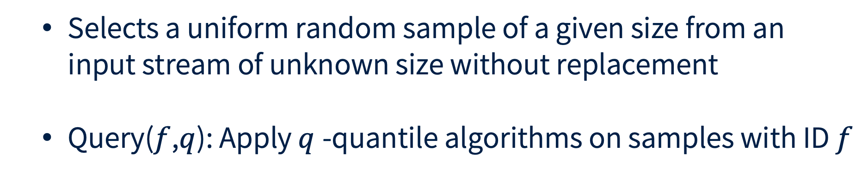
Sampling
  Selects a uniform random sample of a given size from an input stream of unknown size without replacement
  Query($f$,$q$): Apply $q$-quantile algorithms on samples with ID $f$

Slide 19
Sketching
Allocates a separate quantile sketch to track the latency quantiles of each potential heavy hitter.
We use a space-saving instance where each entry, in addition to its counter and ID fields, has a quantile sketch instance.

Slide 20
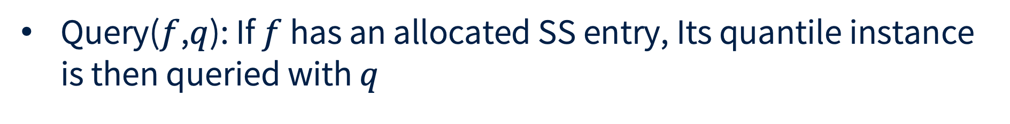
Sketching
Query($f$,$q$): If $f$ has an allocated SS entry, Its quantile instance is then queried with $q$

Slide 21
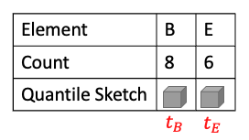
SQUAD
SQUAD combines sampling and sketching
The sampling helps us capture the behavior of the latencies experienced by an item before it was allocated with an SS entry and a quantile sketch.

Slide 22
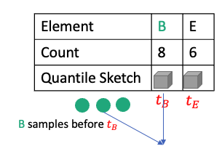
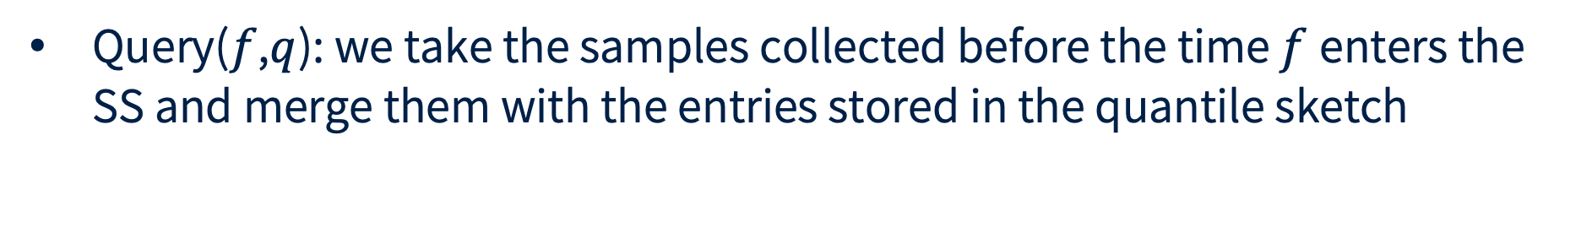
SQUAD
Query($f$,$q$): we take the samples collected before the time $f$enters the SS and merge them with the entries stored in the quantile sketch

Slide 23
Evaluation
Setup
  C++ implementation
  dataset:
    NS3 simulations for a FatTree topology
  Baseline Comparison:
    Quantile Sketches (RND and GK) for the entire stream

Slide 24
Memory vs. Error Percentile

Slide 25
Update Peformance

Slide 26


Thank you!
Rana Shahout
ranas@cs.technion.ac.il
PhD candidate
Computer Science
Technion
@rana-sh
@Ranash2189

