Slide 1
Are You Really a Picky Person?

Slide 2
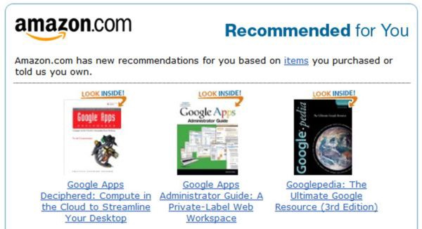
Recommendation Systems

Slide 3
Personalized Content
Helps to improve the on-site experience by creating dynamic recommendations for different kinds of audiences

Slide 4
Recommendation System Goal
Infer users' preferences and provide them with recommendations that enhance their overall experience
How to do this?
From informative users' feedback

Slide 5
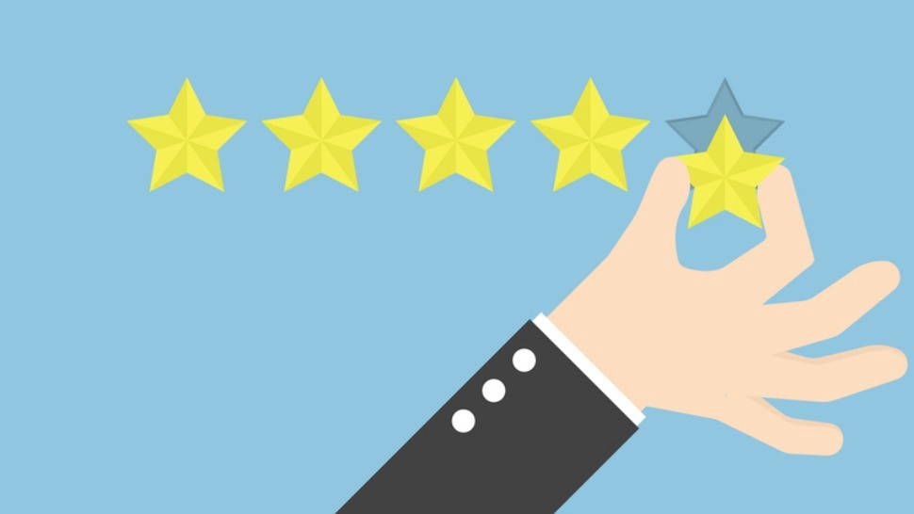
Extreme Ratings of a User
On one extreme: "picky user"
On the other extreme: "superliker"
Why is it bad for the user?
The algorithms fail to learn a user's preferences due to extreme ratings, which can lead to an unpleasant user experience

Slide 6
Intervensions in Rating Systems Design
Does the interface change ratings?
Designing Informative Rating Systems: Evidence from an Online Labor Market
Garg, Nikhil and Johari, Ramesh

Slide 7
How is this related to pickiness?
We ask whether platforms can actually induce pickiness or super-likeness by changing the interface

Slide 8
Step 1
We conduct an experiment that shows how the interface design can change the users’ behaviors in terms of pickiness or suplerlikers (extreme ratings)

Slide 9
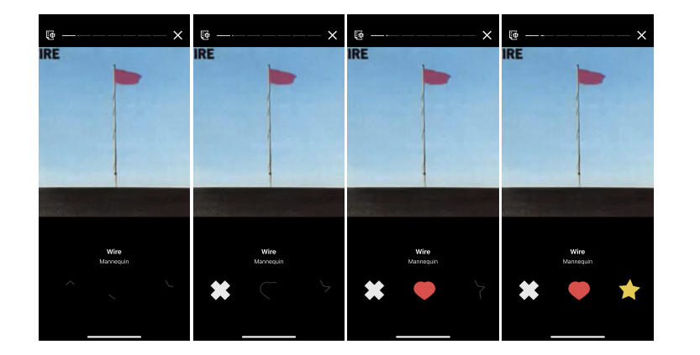
Piki Music App

Slide 10
Three Treatment Groups
Treatment | Dislike lock time | Like lock time | Superlike lock time
a | 3 | 3 | 12
b | 3 | 6 | 12
c | 3 | 9 | 12
Online A/B/C test in which we changed the timer period
of the like button to be unlocked

Slide 11
Step 2
We show how the rating distribution affects the recommenders and how quickly do they learn about the users?

Slide 12
Simulation with RecLab
We simulate the ratings with RecLab using sythetic datasets to control the rating distribution of each group
We consider three recommendation algorithms:
Random
TopK
MF

Slide 13
Simulation with RecLab
We are interested in:
Superlike ratio over time
How often does the recommender recommend a liked song?
Correlation between song quality and the mean rating?

Slide 14
Interface Design
Ratings Received
Effects on the recommendation algorithms
Change timers in the Piki music app
Rating distribution
Experiment: How does changing the time until giving a specific rating affect the rating distribution?
Simulation: How does the rating distribution affect the recommenders and how quickly do they learn about the users?

Slide 15
Results (till now..)

Slide 16
Setup
Piki music app
Number of users: 484 users
Median rating per user:
(a) 49
(b) 68
(c) 56
Total number of rating: 80K
Duration: 5 weeks

Slide 17
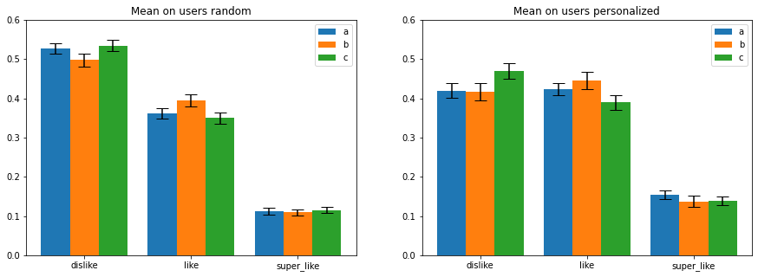
Users ratings

Slide 18
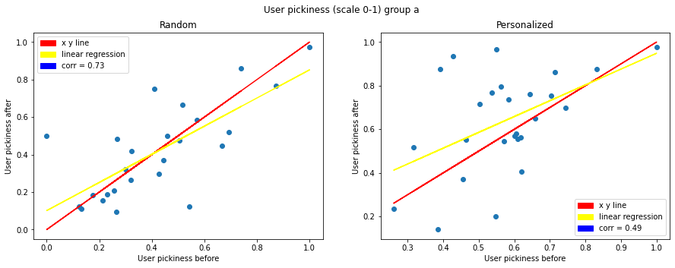
User pickiness before and after (a)

Slide 19
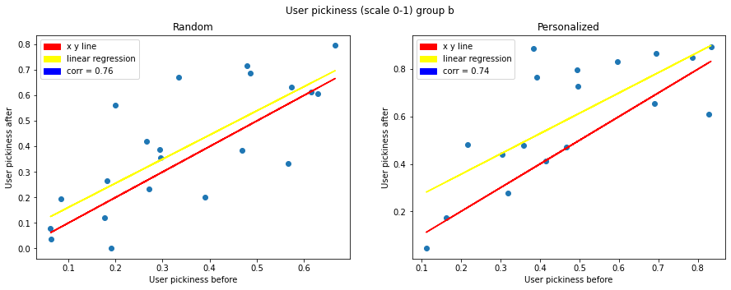
User pickiness before and after (b)

Slide 20
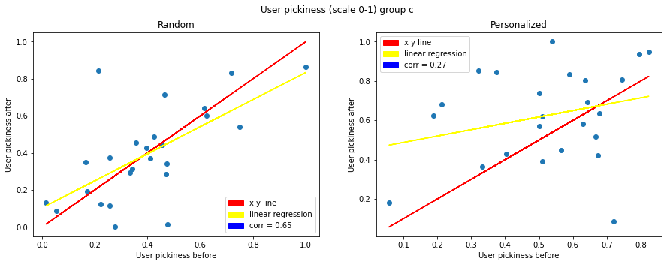
User pickiness before and after (c)

Slide 21
Funnel across treatment groups

